Slide 1
World Engineering Day 2023 Celebration at Senate of Czech Republic The role of professional engineers and engineering in addressing the current state of society and expected developments; preparing engineering professionals and ensuring continuing professional growth.
Alfredo Soeiro
AECEF, UPorto
14 March 2023

Slide 2
Some facts about Engineers and Continuing Professional Development
Engineering bodies – Engineers Europe (ex-FEANI), Engineers Ireland, Engineers Malaysia
Educational Associations – SEFI Working Groups, ASEE, JSEE
Industry – Internal universities
Higher education – Georgia Tech, Stanford
Government - CACEE
Private – HolonIQ, Evolllution
Mixed - IACEE

Slide 3
Promoting Online Training Opportunities for the Workforce in Europe"
EASME/DG GROW of the European Commission “Towards an efficient learning ecosystem for European SMEs: Fully exploiting the potential of online training”
Work based learning – Provider, employer, individual, learning contract
Accreditation and validation
Little or No time for external training
Needs are Just in time
Diversity of training
None or small funds

Slide 4
E4E - Engineers for Europe
European Engineering Professional Skills Council New Trends in Engineering Education Innovative Training

Slide 5
Consortium 13 organisations from 8 EU countries
Duration 36 months
Grant EUR 1.5 million (Engineers Europe – previously FEANI : EUR 268k)
Donor EU Commission, Programme Erasmus+
Score 89/100 total score (25/25 for Relevance criterion)

Slide 6
WP 3 Develop Innovative E4E Curriculum & Training
Benchmark Occupational Profile against EQF, ESCO, EU Skill Panorama
Develop demand-driven joint curricula (HE + VET + Profession / Industry)
Align EQF, EQVET, EQAVET
Develop training materials, teaching methodologies and delivery means
Certification: set up certification model/mechanism/process
WP 6 Dissemination & Exploitation
WP 2 E4E Skills Council; Skills Anticipation and Monitoring
Structural knowledge of partners
Methodology to assess & anticipate training needs and mismatches
Engineers Skills Strategy
Extract knowledge and praxis
Develop occupational profiles
Define skill sets
Skill anticipation strategies
WP 5 Quality Assurance
Foresight with global practitioners
WP 4 Deliver E4E Training
- Deliver the E4E curricula
- Validate content and structure
- Finalise E4E Curricula
- Develop manuals and tools for full-scale deployment and uptake of E4E education and training solutions
Fiches of initiatives, examples, case studies
Yearly monitoring and strategy update

Slide 7
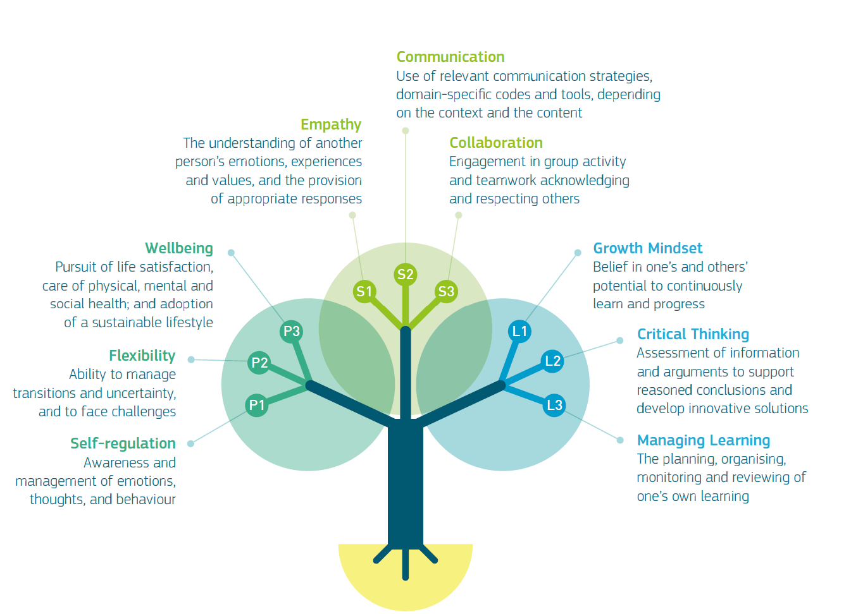
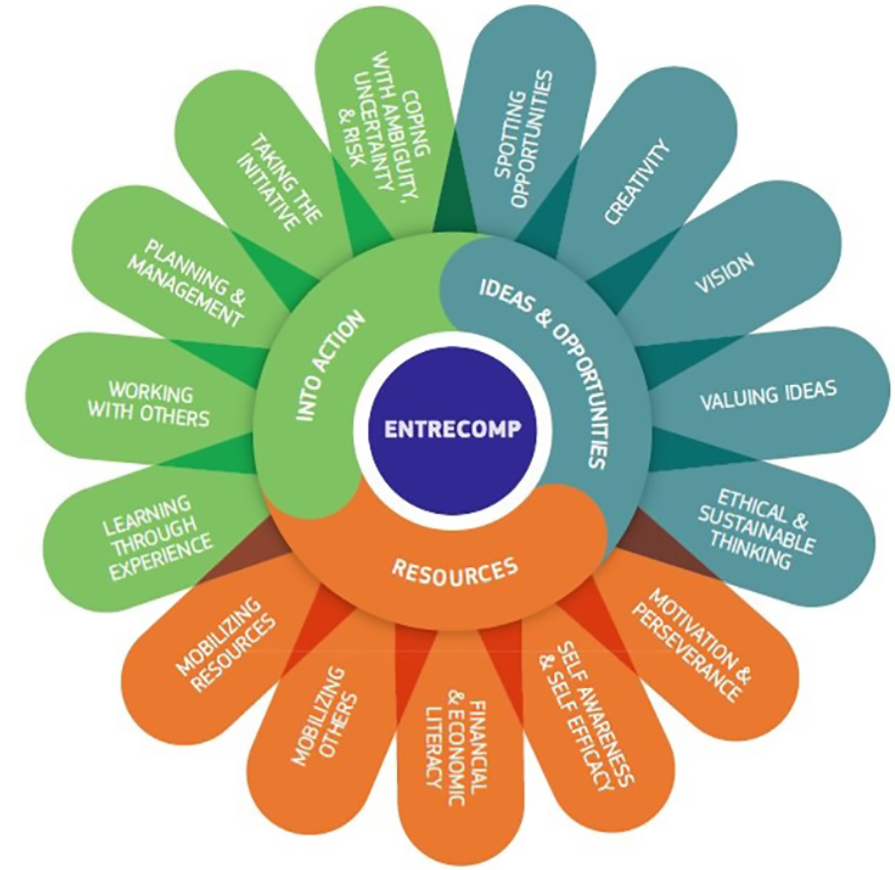
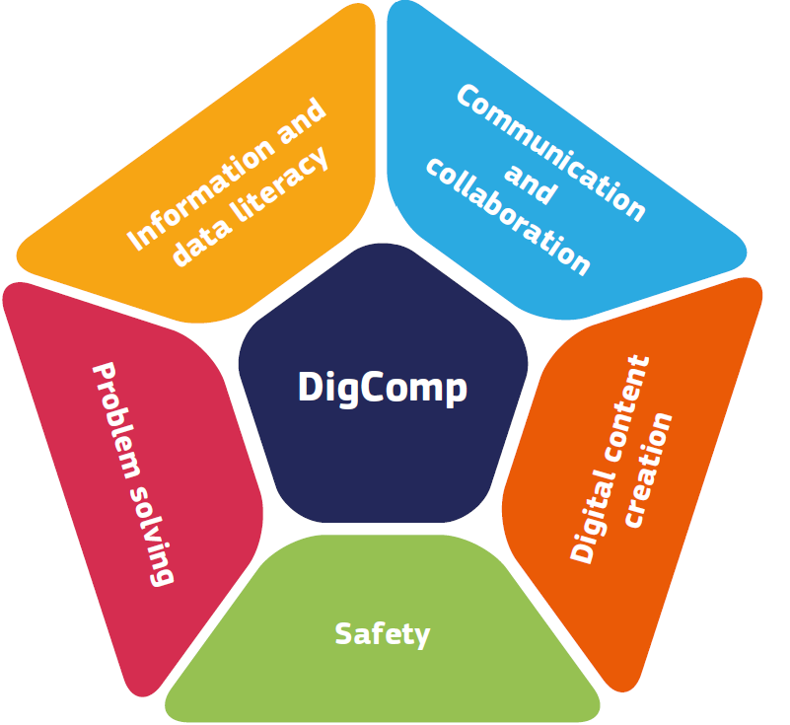
E4E Course on Life Competences
Module 1 - Empathy
Module 2 - Flexibility
Module 3 – Self Regulation
Entrepreneurship Skills
Module 1 – Financial & Economic Literacy
Module 2 – Creativity
Module 3 – Planning & Management
Green Skills
Module 1 – Embracing complexity in sustainability
Module 2 – Envisioning sustainable futures
Module 3 – Acting for sustainability
Digital Skills
Module 1 – Safety / Cybersecurity
Module 2 – Information
Module 3 – Data literacy

Slide 11
Green Comp

Slide 13
Děkuji!
Thank you!

